Slide 1


Integrative Project LAPR4
2DF-G03 / Group Elements:
Nuno Alves – 1201427
Pedro Sousa – 1201428
Sérgio Lopes – 1200625
Tiago Freitas – 1200628
Vasco Azevedo - 1202016

Slide 2

Index
Achieved Results
SWOT Analysis
Evidence of Software Engineering
Deployment Solution
Product Solution
Product Quality
Improvements
Self-Assessment

Slide 3


Achieved Results
All User Stories were implemented.
Most of the Functionalities are working.
Improvement as team work.

Slide 4



SWOT Analysis
Strengths
Weaknesses
Adaptability;
Communication;
Teamwork;
Playing with deadline;
Opportunities
Threats
Better knowledge for future;
There are a few functional tests, even if we tried to test all the classes;

Slide 5

Applying the software engineering
We applied the software engineering using:
UI and Controllers
Encapsulation and Inheritance

Slide 6

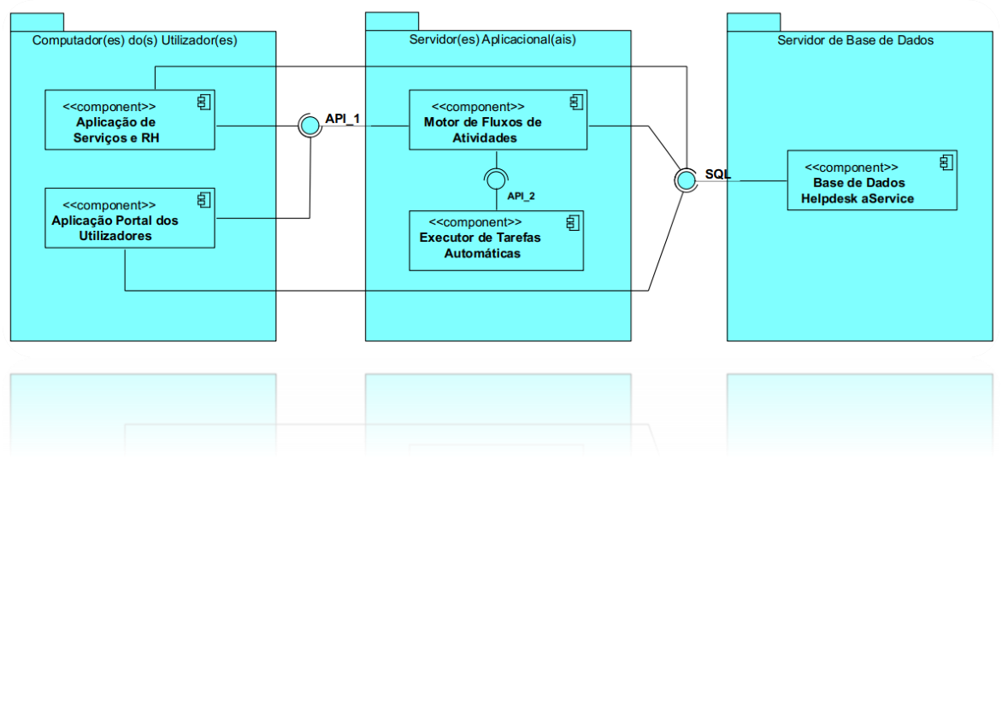
Deployement Solution
Our project has a few applications interconnected that allow us to have several functionalities, such as:
Portal
RH services
Flow engine
Auto task runner

Slide 7

Product Quality
We tried our best to implement the product with all the requirements and functionalities asked by the client;

Slide 8

Improvements
Start Earlier on the development of US
Interact more with each other

Slide 9
Self-Assessment

Slide 10

Thank you

